Slide 1

So Many Conditions, So Little Time: How Patients and Providers Prioritize and Manage the Treatment of Discordant Chronic Comorbidities
Gabrielle Cantor
Indiana University Bloomington
gcantor@iu.edu
@gabriellecantor
Co-Investigators: Kay Connelly, James Clawson, Patrick Shih, Tom Ongwere, Sergio Ramirez Martin
Sponsored by National Science Foundation Grant Number XXX
Notes:
-Make sure to introduce title and say what DCC is
-don’t say the title
-maybe make another slide with DCC definition
-make sure the contribution is clear

Slide 2
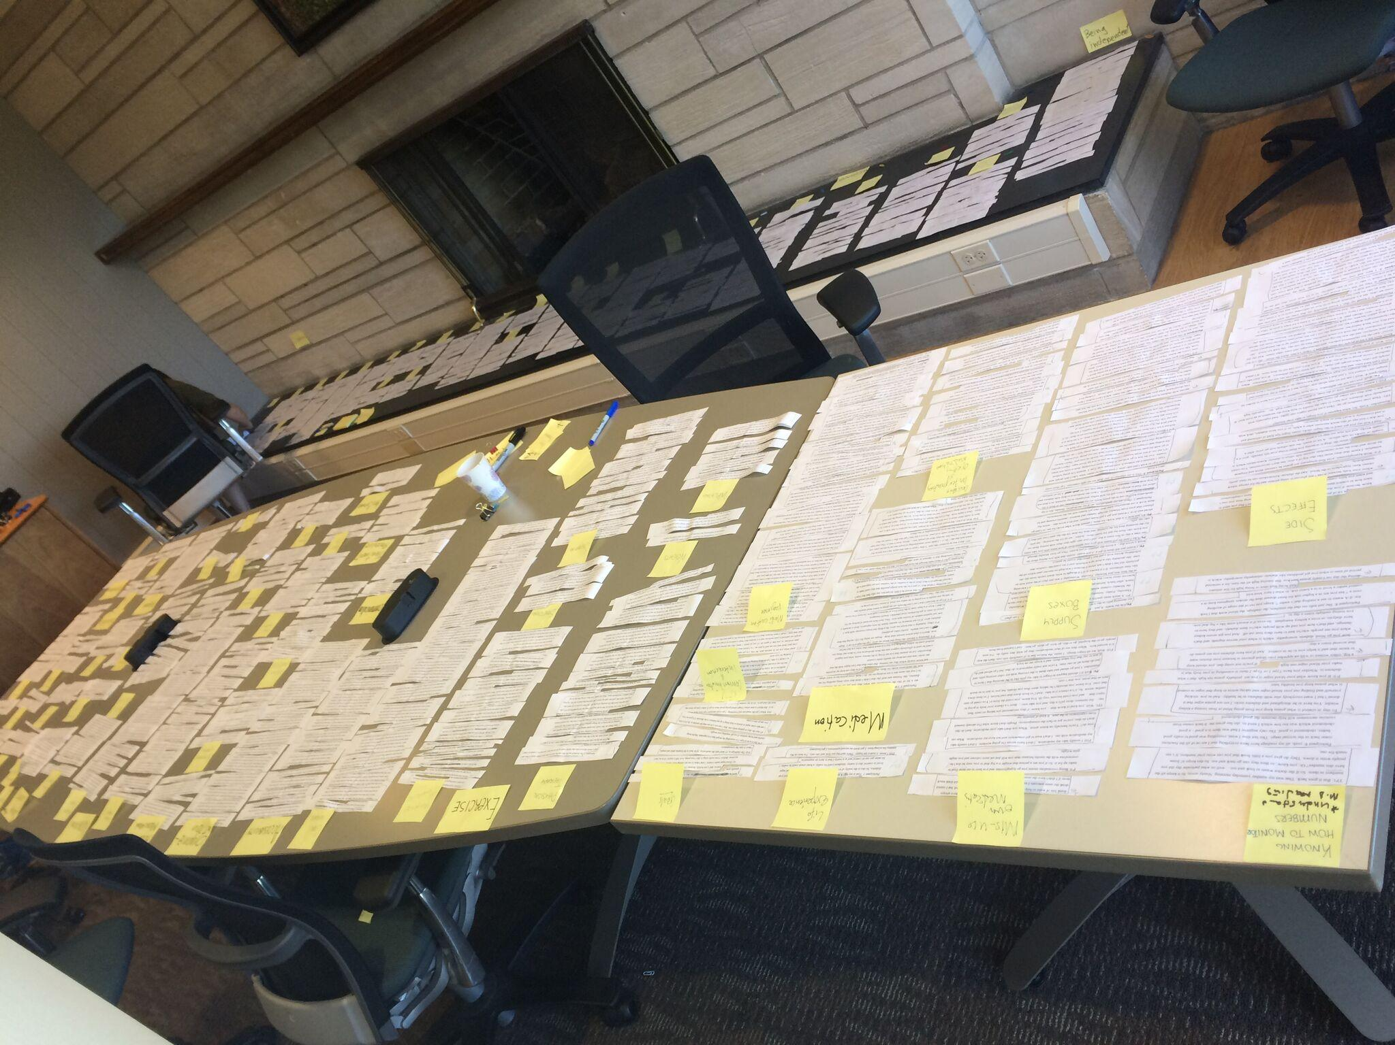
THE STUDY
16 Participants
Type 2 Diabetes + Other Chronic Conditions
PEI Study
Qualitative Analysis

Slide 3
PATIENT PROBLEMS
Communication between Patients and Providers
Polypharmacy
Prioritizing Treatments
Altered Life View
Financial concerns
Compounding Effect of Multimorbidities

Slide 4
PATIENT SOLUTIONS
Synced Medical Records
Medication Management
Access to Information
Establishing Support Networks
Incorporate Routine into Daily Life
Focus on Holistic Care

